Slide 1
Applied Pixel Art
Applied Pixel Art
Maksim Surkov

Slide 2
Motivation (why pixel art?)
Does not take much resources to produce
Yet a distinctive and cool visual style
Resulting products are lightweight and have low system requrements
Allows you to concentrate on more important things than graphics

Slide 3
Some clarification
I can start making pixel art right away and it will be good.
>With some art experience maybe
Pixel art is just downscaled clipart.
>No, it’s a distinctive art style

Slide 4
Quick intro to tools
Aseprite - pixel art editor with simple interface and extensive functionality
Unreal Engine 4 - game engine, has built-in plugin (Paper2D) to work with tilesets and other stuff
(we won’t get in details into it)
MagicaVoxel - free tool for voxel art creation
Some additional useful stuff (Adobe Color, Gimp)

Slide 5

Basics
Recommended reading
We’ll just cover few topics from this book

Slide 6


Don’t be afraid of gaps
Lines (pixel-perfect)
Shapes

Slide 7
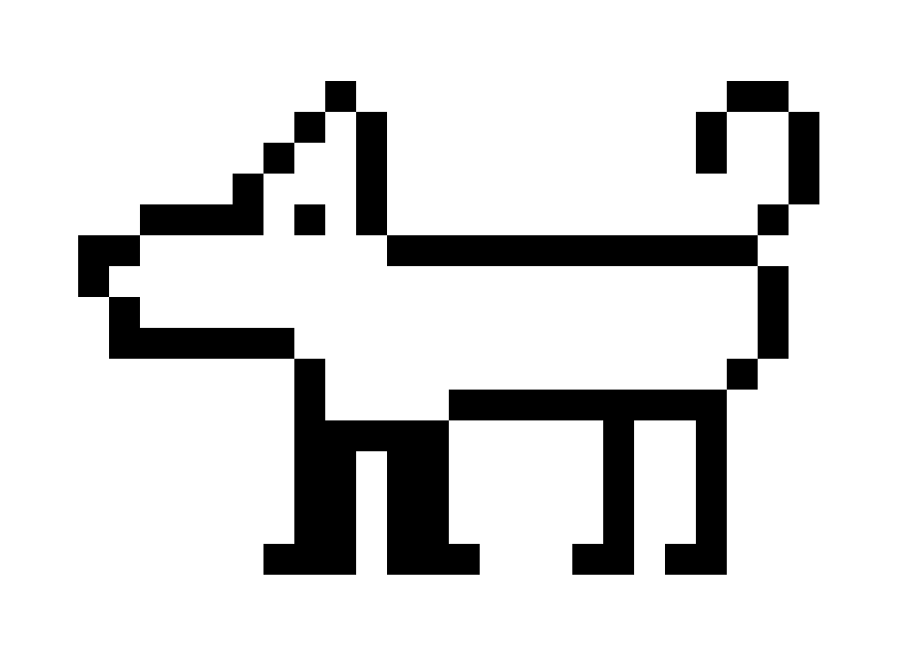
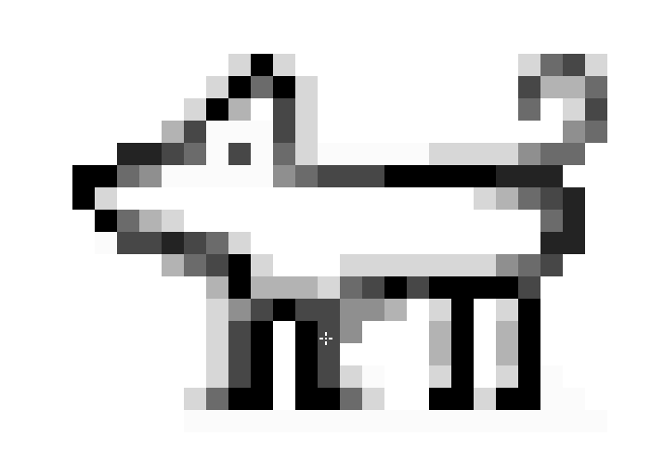
Anti-aliasing
Before
After

Slide 8
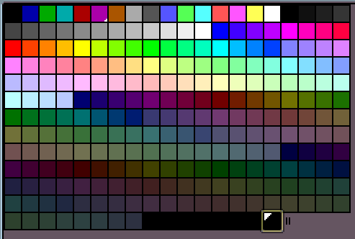

Palettes
N-bit palette gives you 2^n colors
Example of 4 -bit
Example of 8 - bit
(VGA 13h)

Slide 9
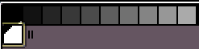
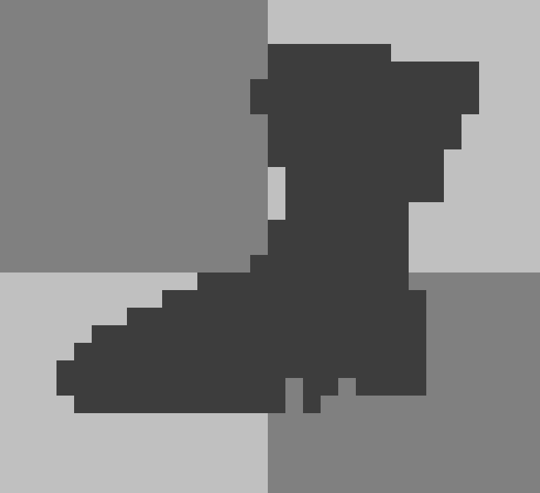
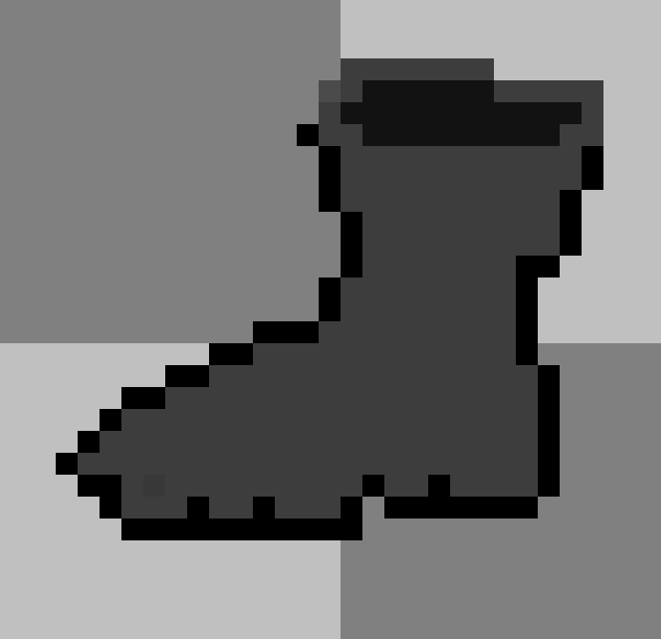
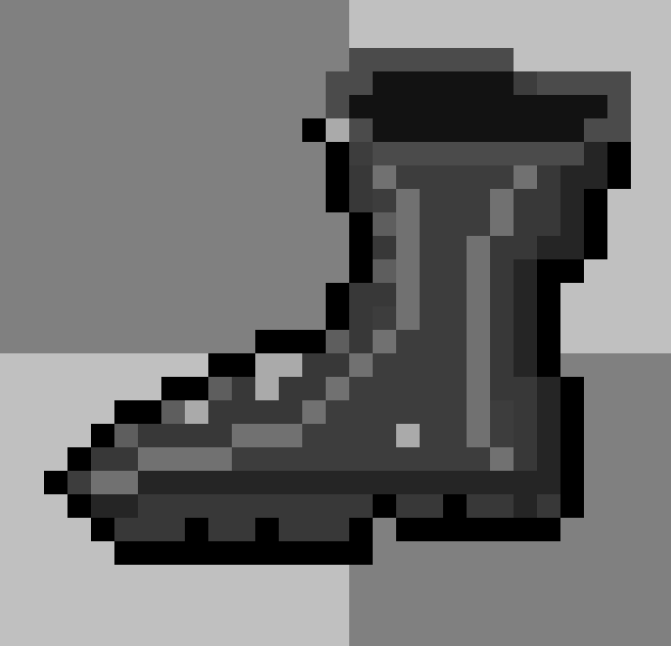
Palettes
Color Ramp (Gradient)
Draw a boot example

Slide 10
Palettes
Adobe Color can help you with palette selection for various objects
https://color.adobe.com/ru/explore/

Slide 11
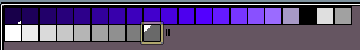
Palettes
Night sky example

Slide 12
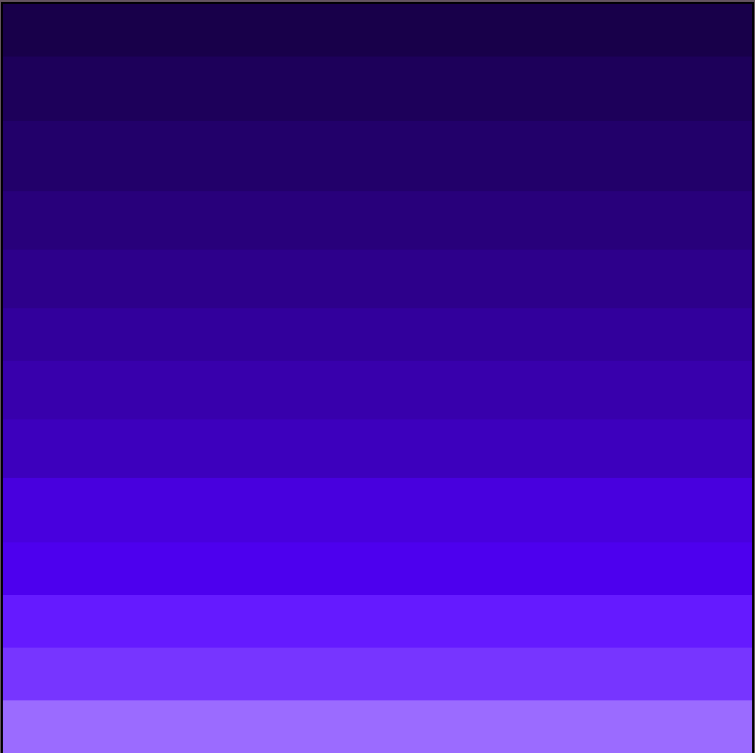
Palettes
Night sky example
128x128

Slide 13
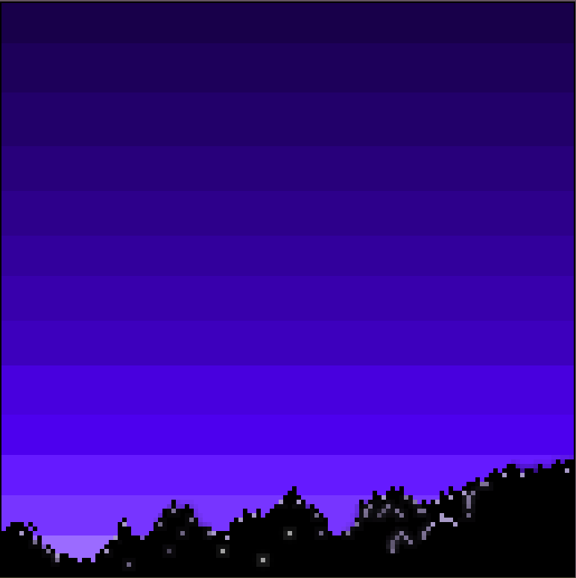
Palettes
Night sky example

Slide 14
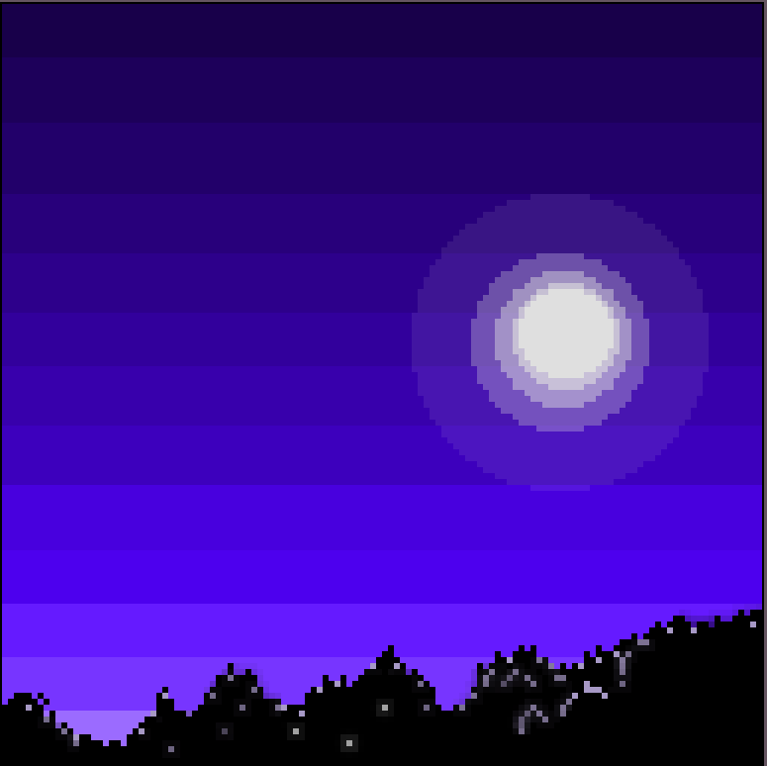
Palettes
Night sky example

Slide 15
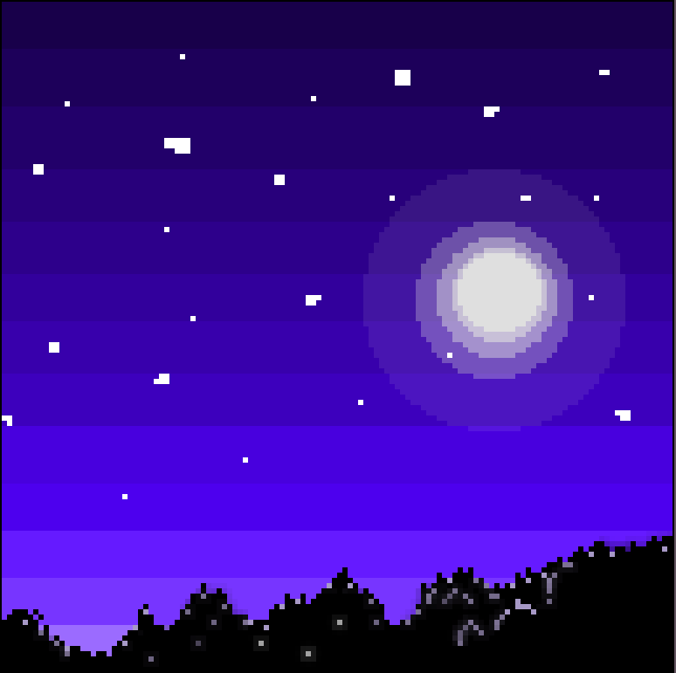

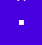

Palettes
Night sky example

Slide 16
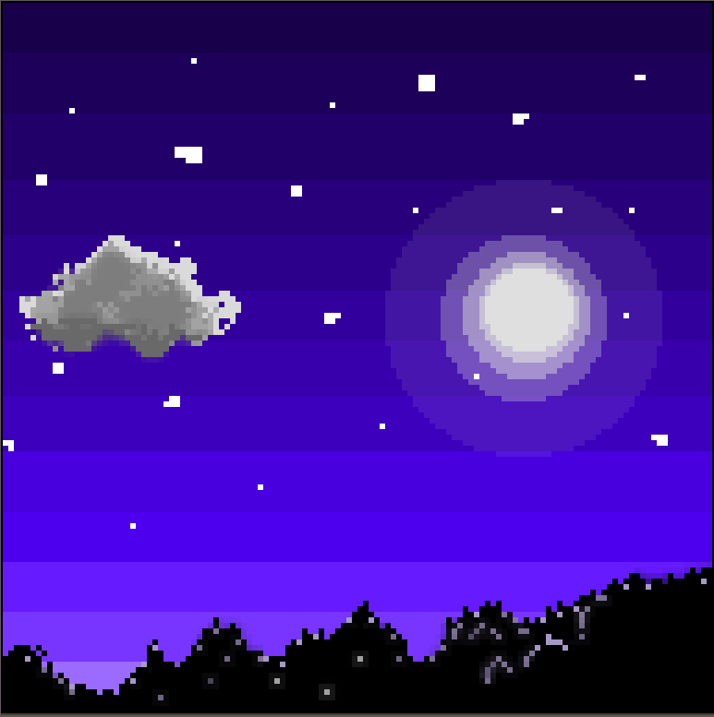
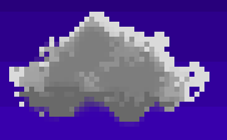
Palettes
Night sky example

Slide 17
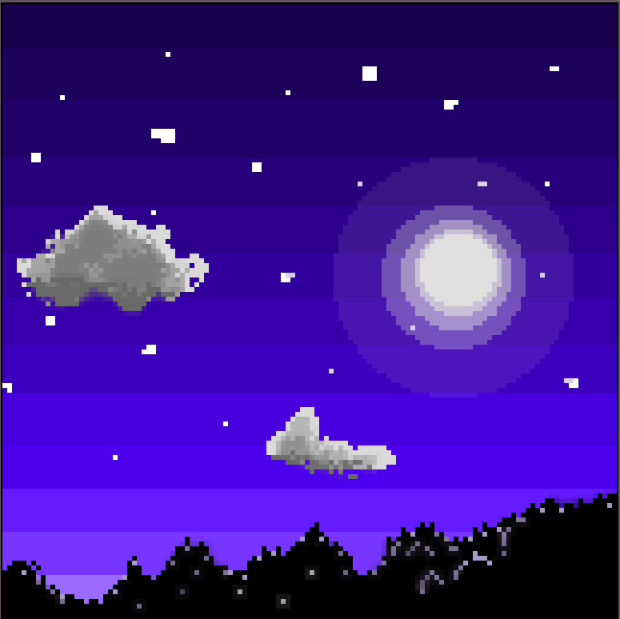
Palettes
Night sky example

Slide 18
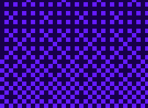
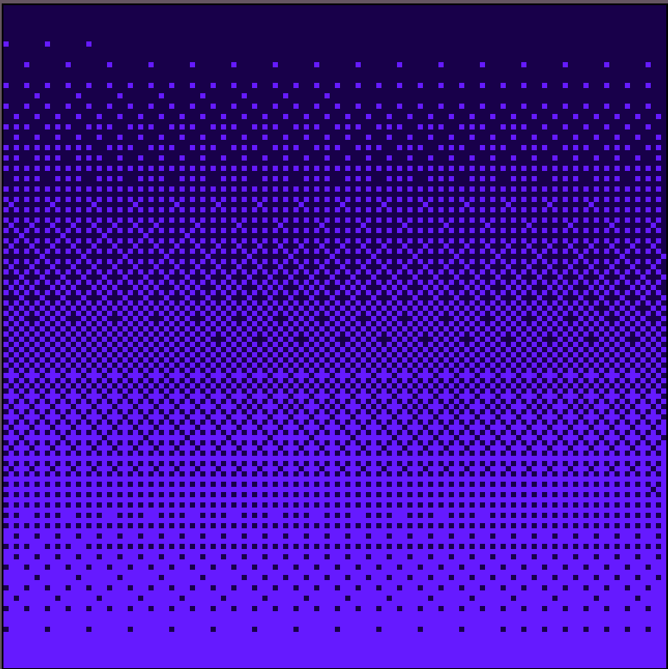
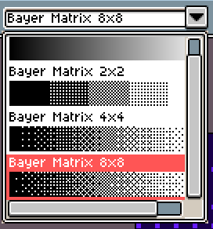
Dithering

Slide 19
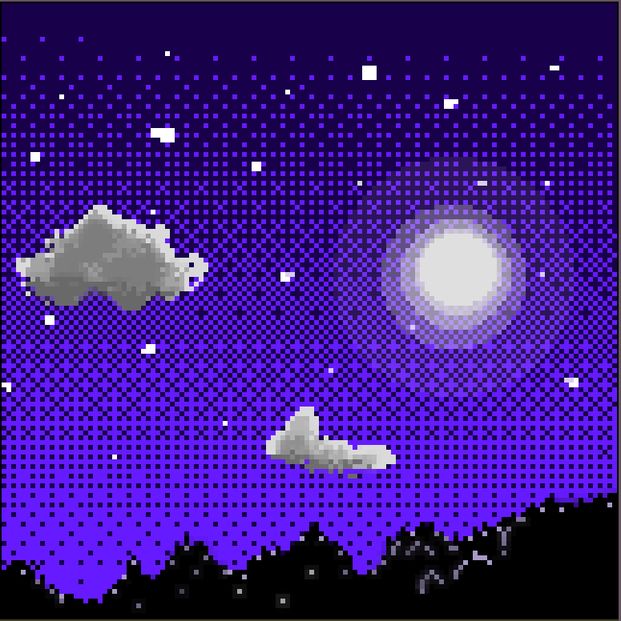
Dithering

Slide 20
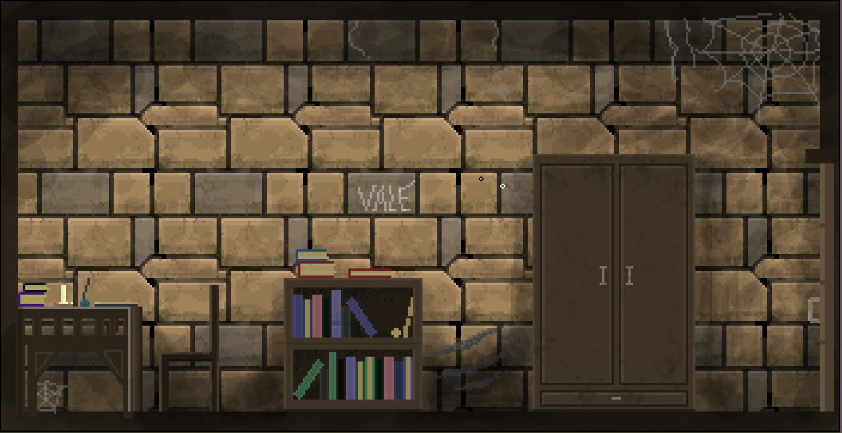
Tileset
Scene initially created as a whole piece

Slide 21
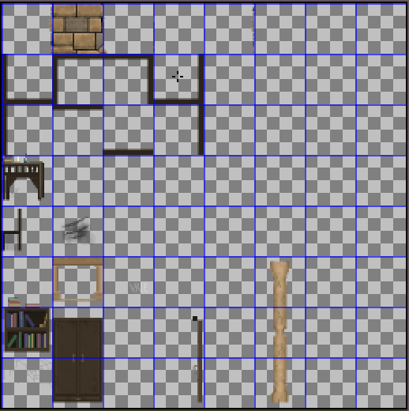
Tileset
A collection of assets broken up into a uniform grid.
64x64 tiles
This tileset is not complete btw.

Slide 22
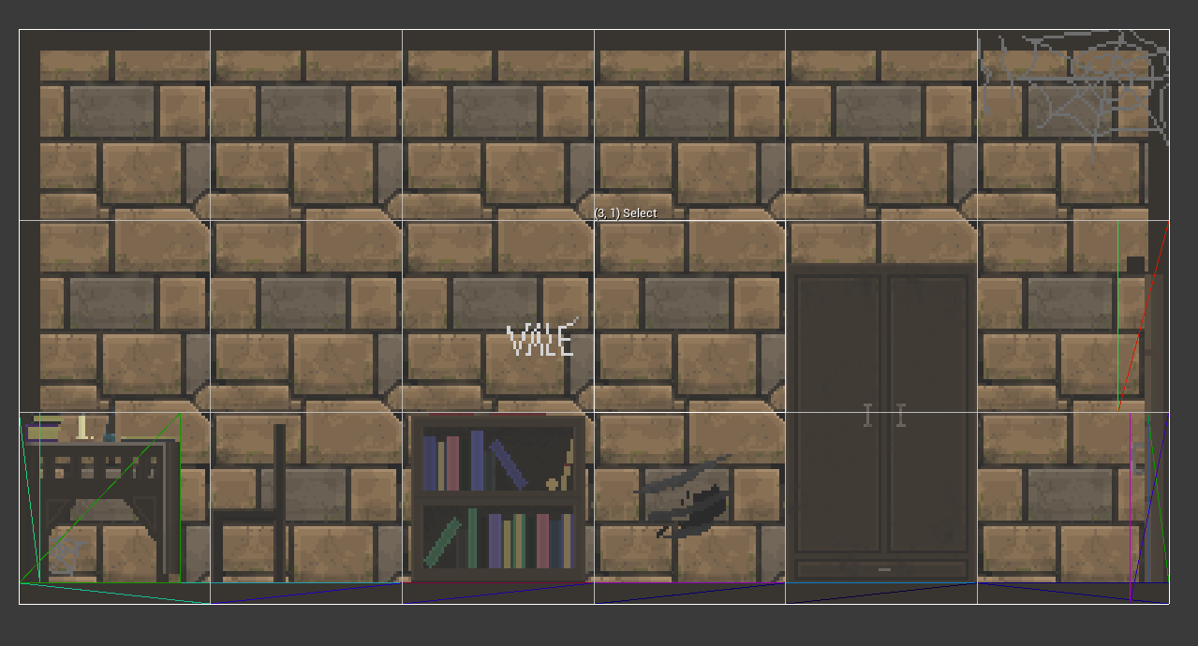
Tilemap
Initial scene converted into tilemap

Slide 23
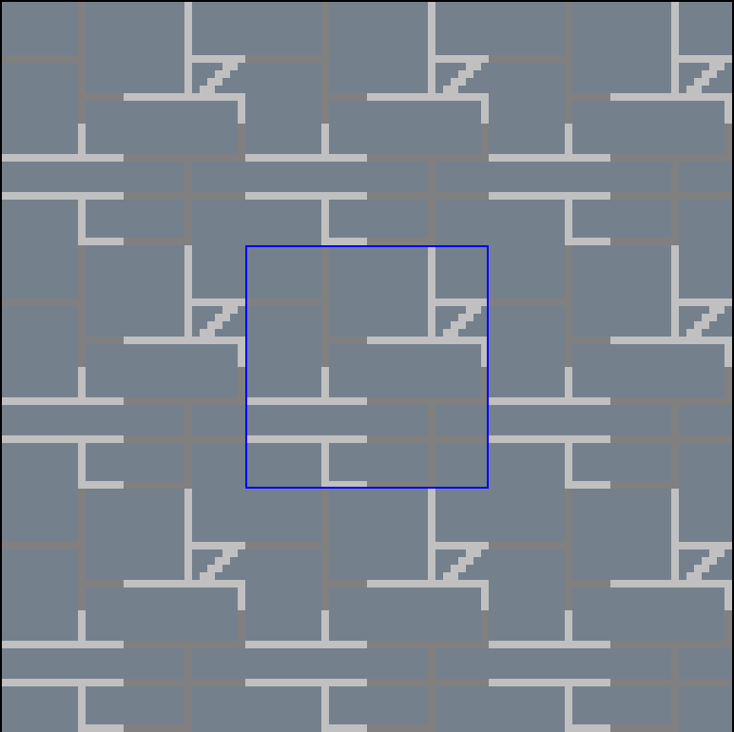
Seamless tile
Tiled bricks example
Outline basic shape

Slide 24
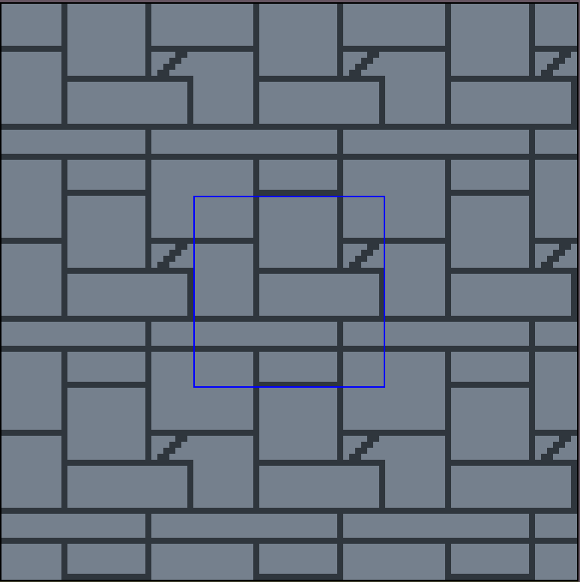
Seamless tile
Tiled bricks example
Fill gaps

Slide 25
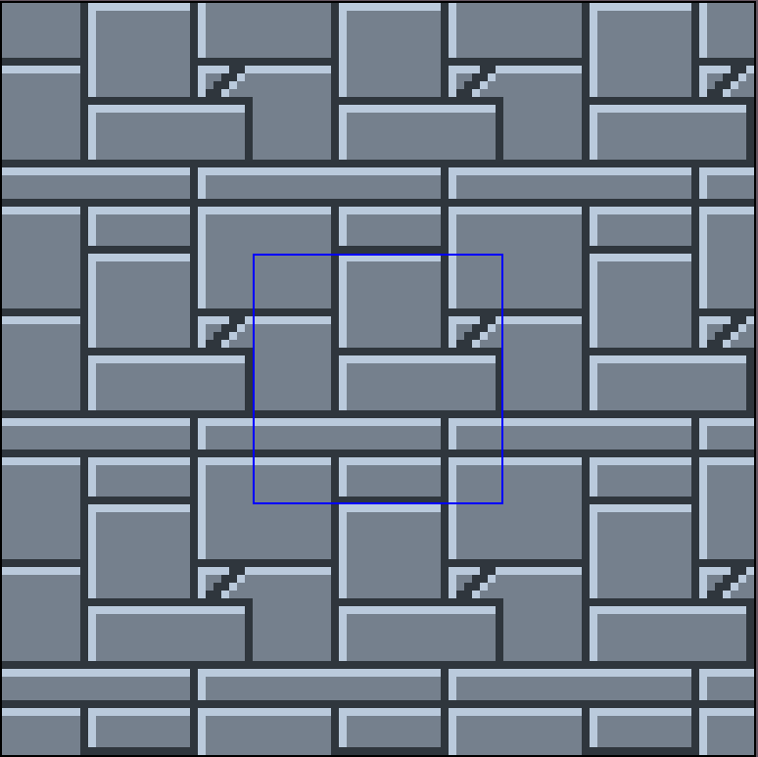
Seamless tile
Tiled bricks example
Light edge from top left corner

Slide 26
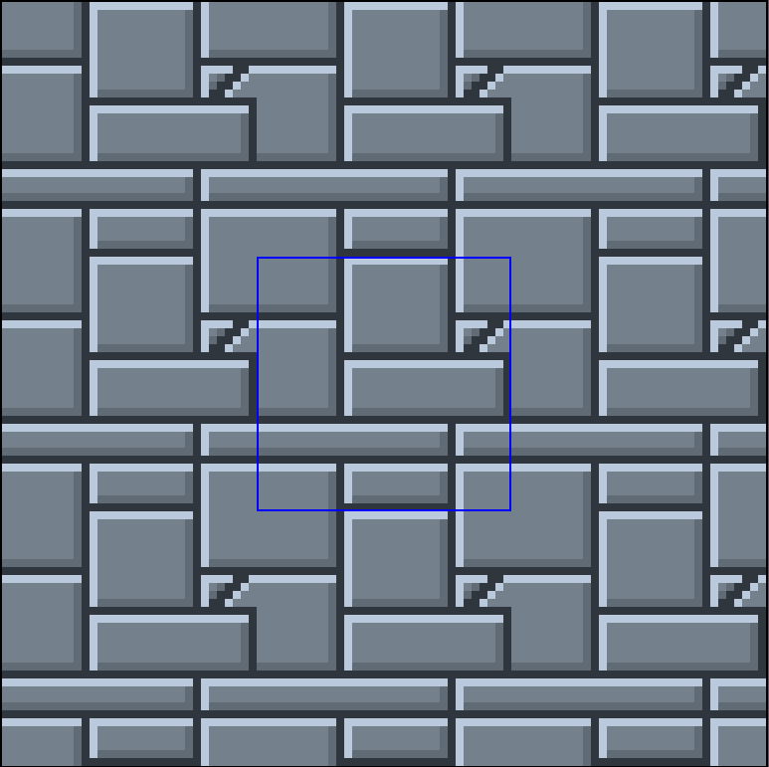
Seamless tile
Tiled bricks example
Dark edge from bottom right corner

Slide 27
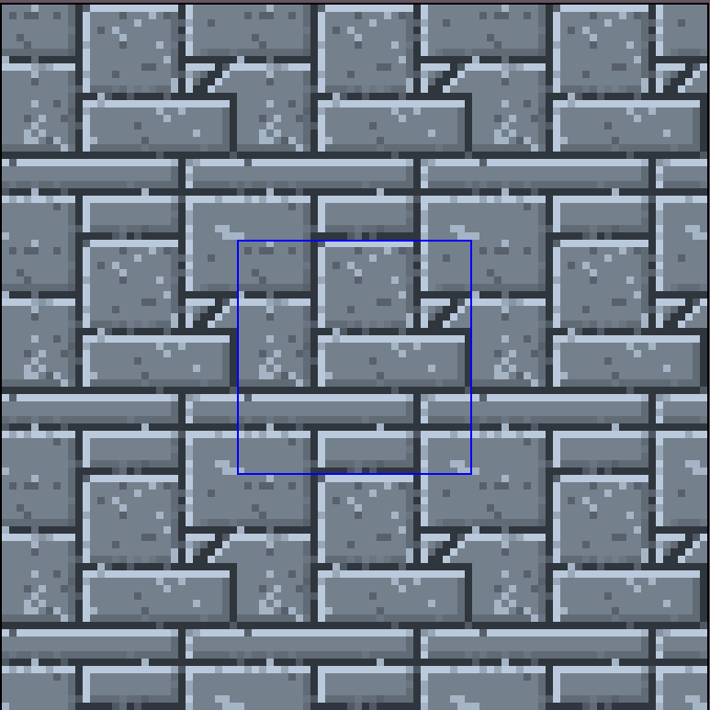
Seamless tile
Tiled bricks example
Add some dust

Slide 28
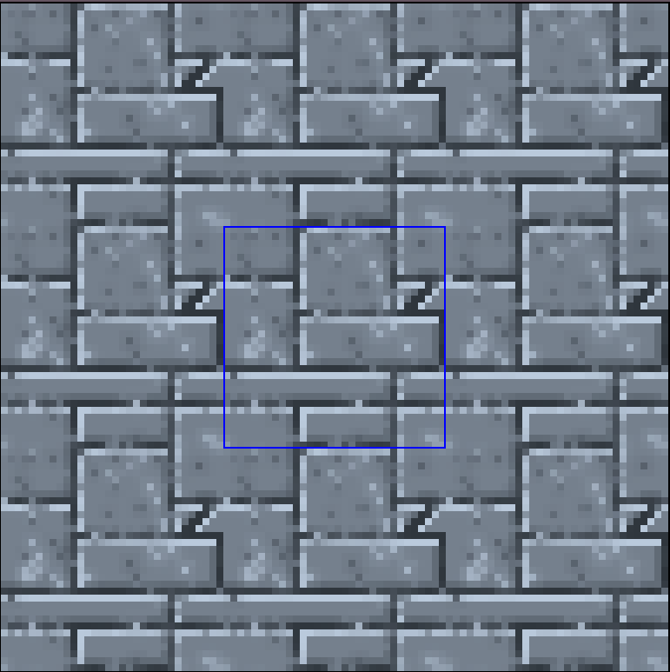
Seamless tile
Tiled bricks example
Blur the dust a little

Slide 29
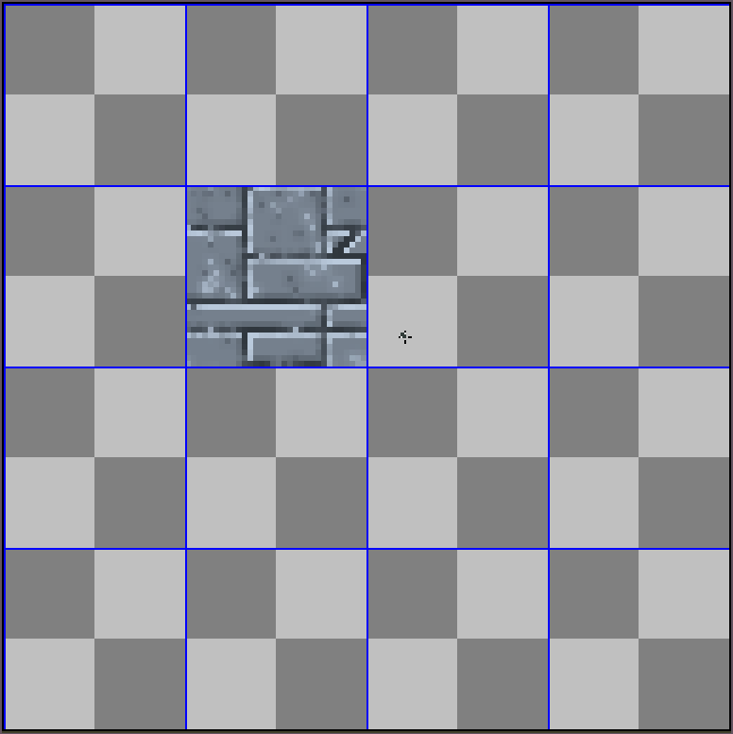
Seamless tile
Tiled bricks example
Throw resulting tile onto tileset

Slide 30
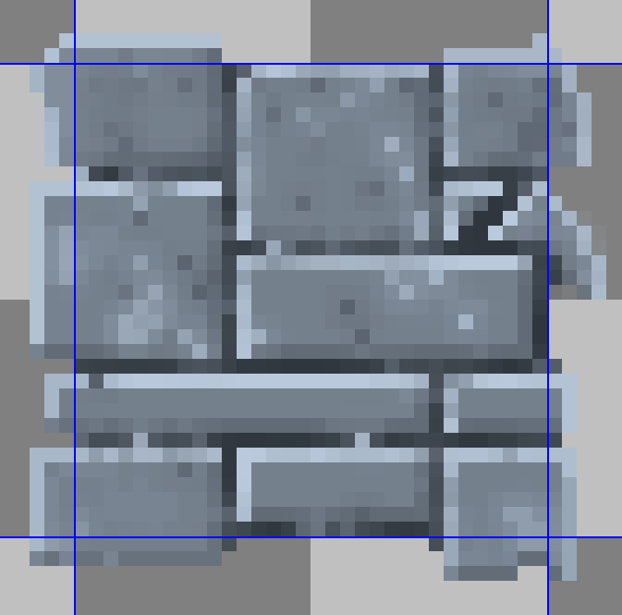
Seamless tile
Tiled bricks example
Outline it to make more universal

Slide 31
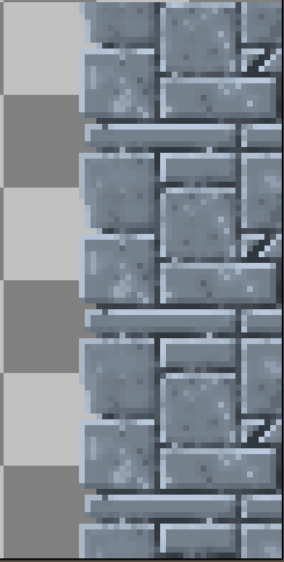
Seamless tile
Tiled bricks example
Usage

Slide 32
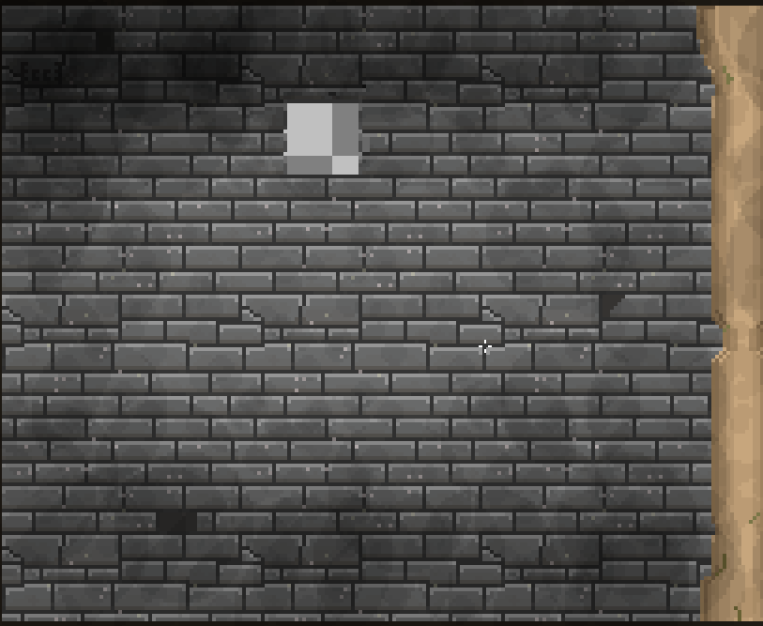
Seamless tile
Tiled bricks example
Make variations

Slide 33
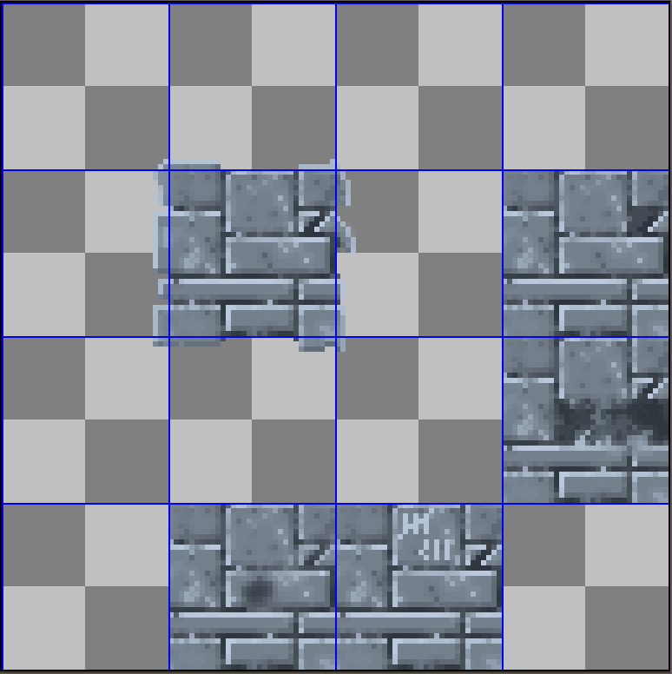
Seamless tile
Tiled bricks example
Introduce variations

Slide 34
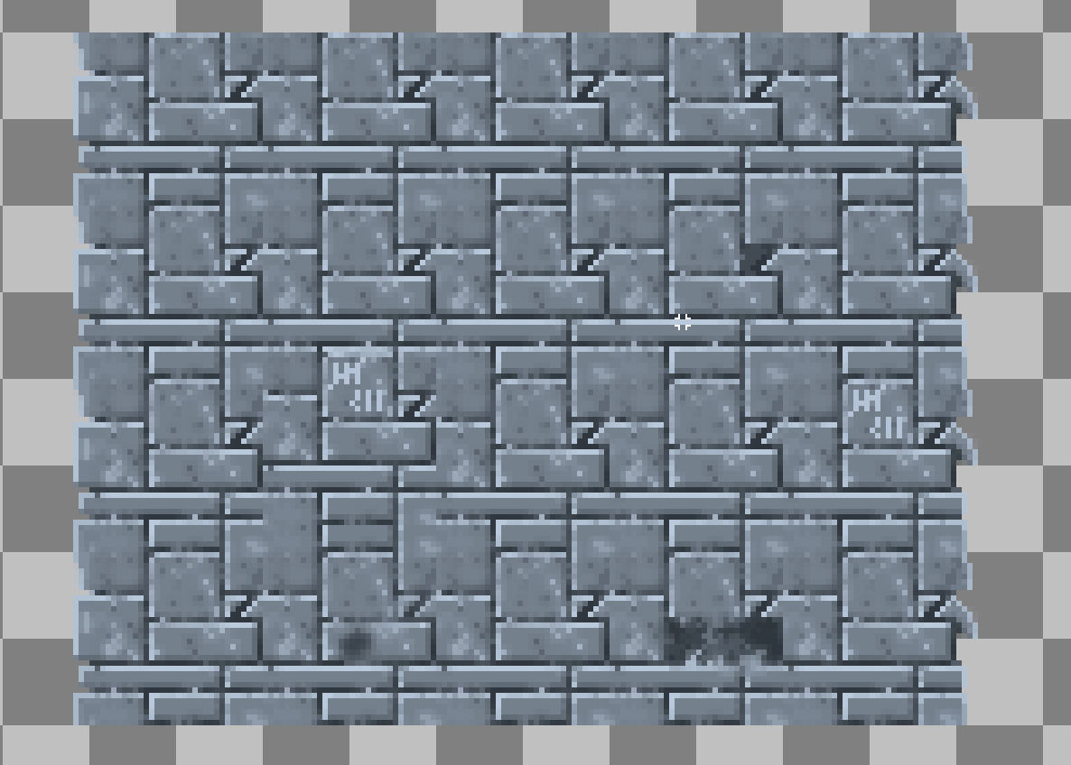
Seamless tile
Tiled bricks example
Introduce variations

Slide 35
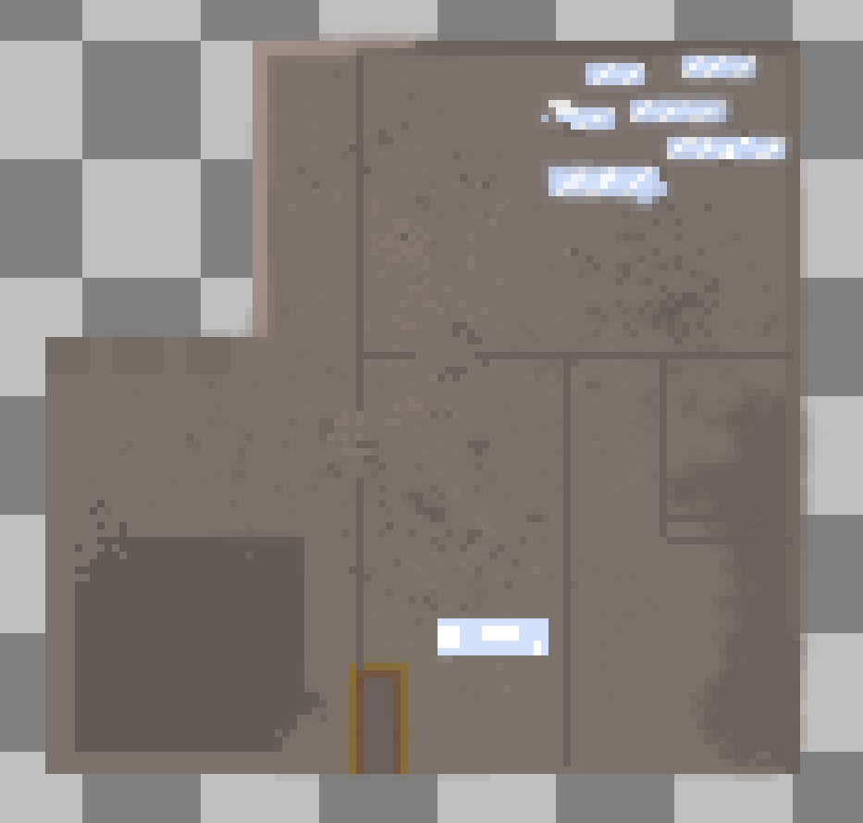
Composition trick
Primary, Secondary, Tertiary shapes
Something looks off, what exactly?

Slide 36
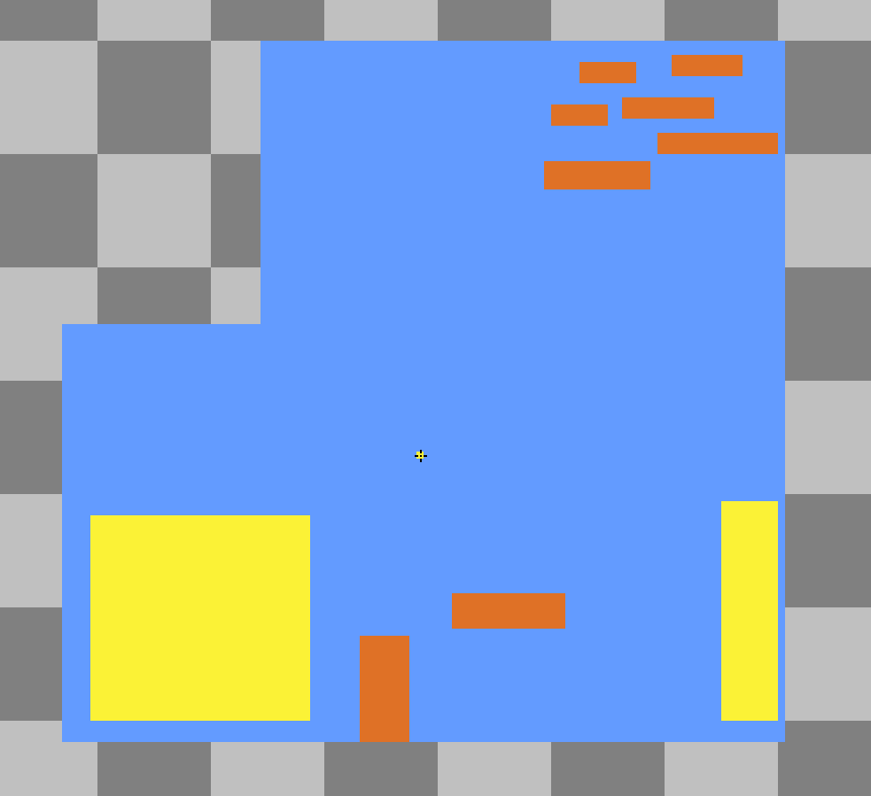
Primary, Secondary, Tertiary shapes
Let’s analyze

Slide 37
Primary, Secondary, Tertiary shapes
Let’s analyze
> Bad distribution of shapes

Slide 38
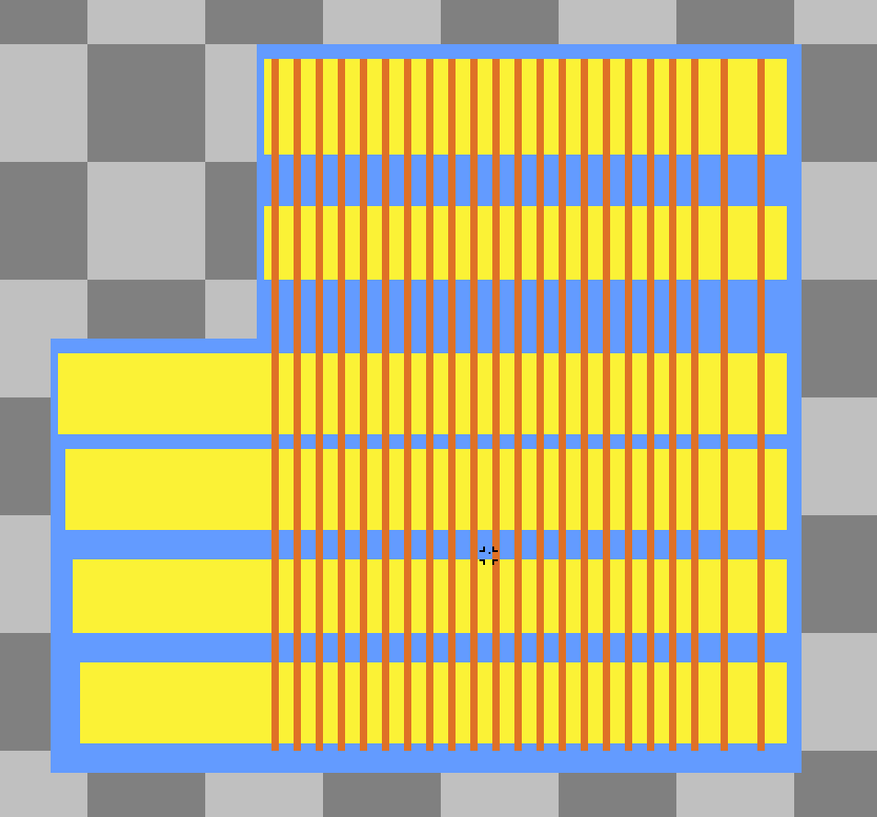
Primary, Secondary, Tertiary shapes
Another example
> What this time?

Slide 39
Primary, Secondary, Tertiary shapes
Eye has no place to rest on

Slide 40
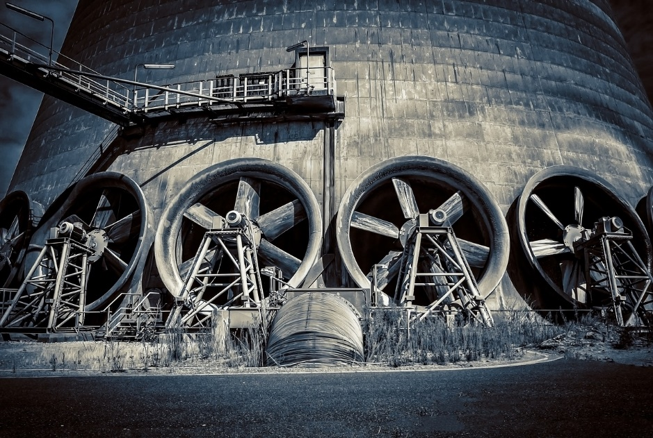
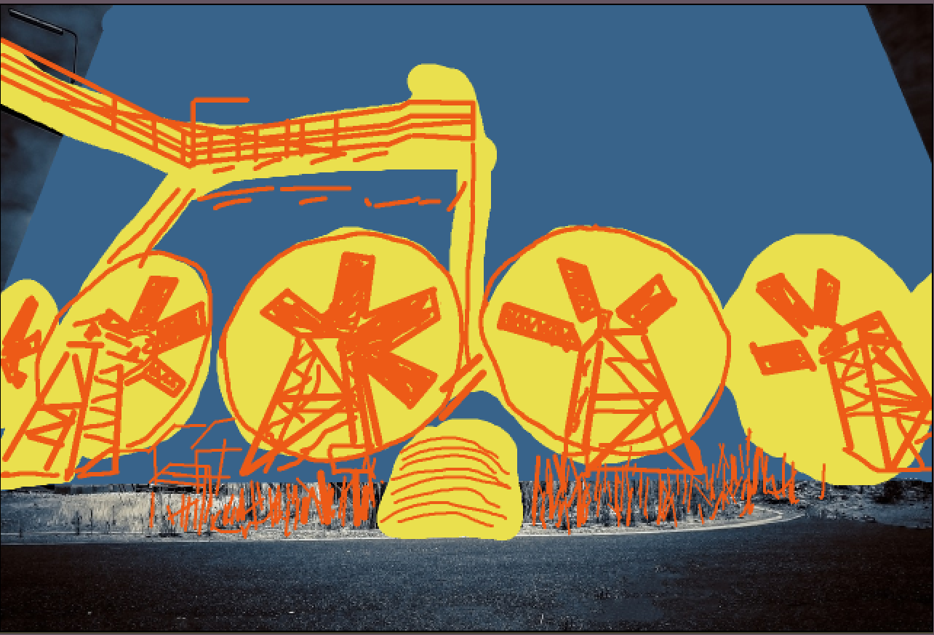
Primary, Secondary, Tertiary shapes
In reality

Slide 41
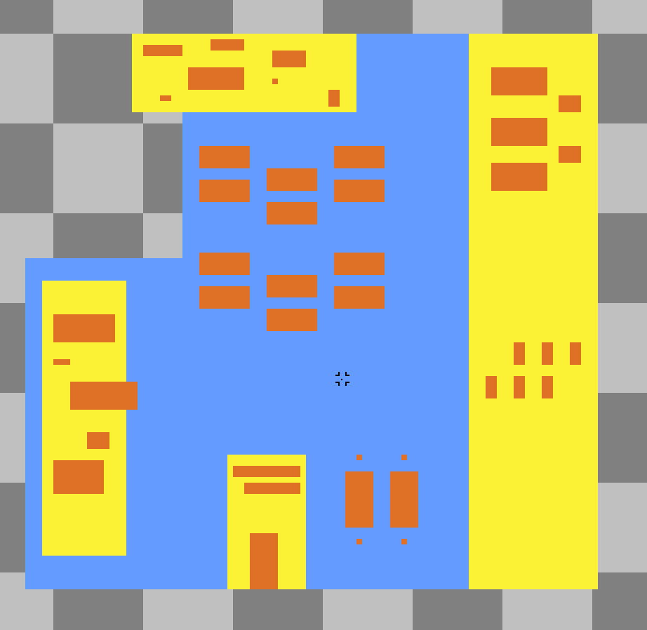
Primary, Secondary, Tertiary shapes
Finally...

Slide 42
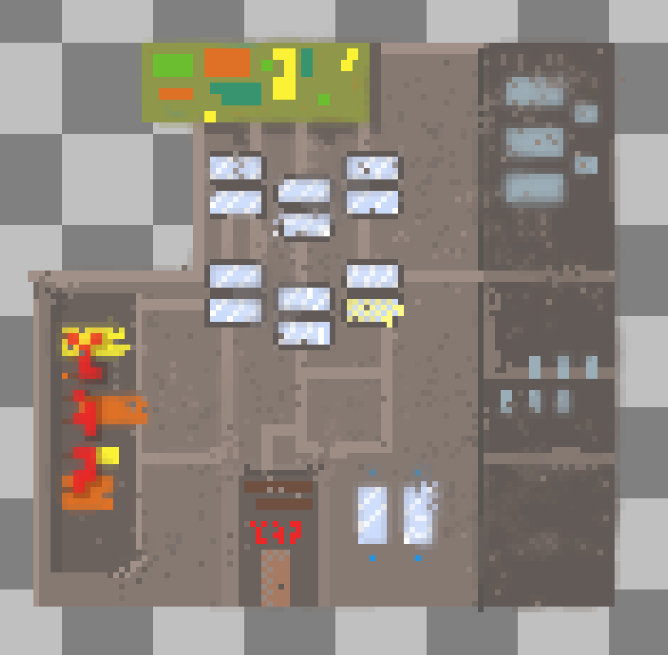
Primary, Secondary, Tertiary shapes
Quick Implementation

Slide 43
Animations
How to start from nowhere?

Slide 44
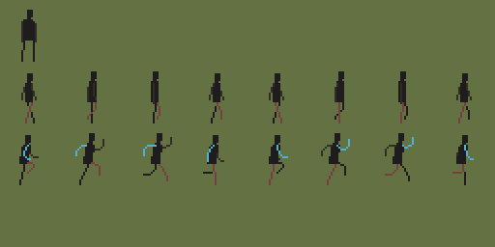
Animations
1. Start from a stickman

Slide 45
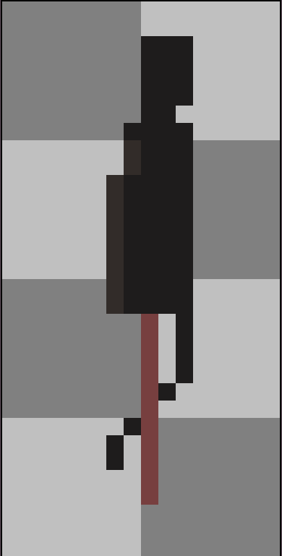
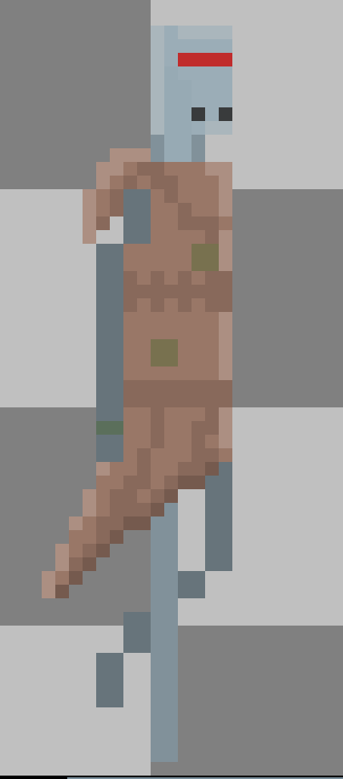
Animations
1. Start from a stickman

Slide 46
Animations
1. Start from a stickman

Slide 47
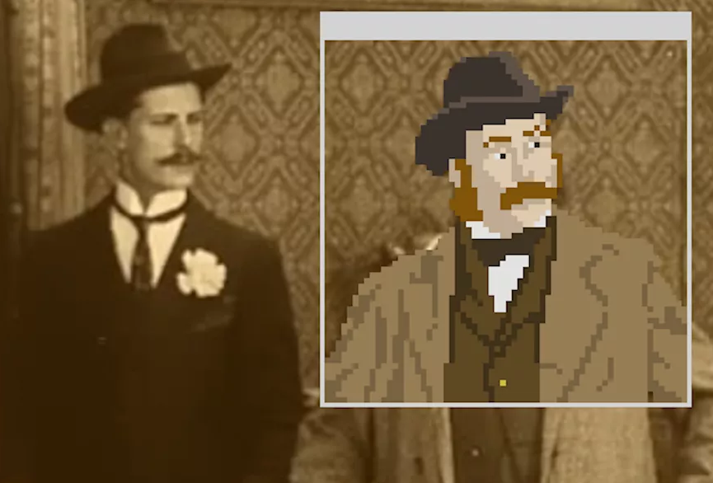
Animations
2. Rotoscoping

Slide 48
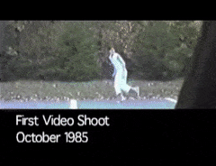
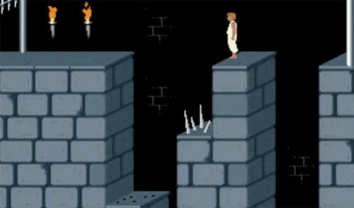
Animations
2. Rotoscoping (Prince of Persia 1989)

Slide 49
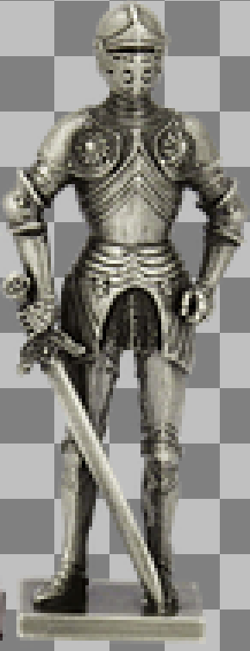
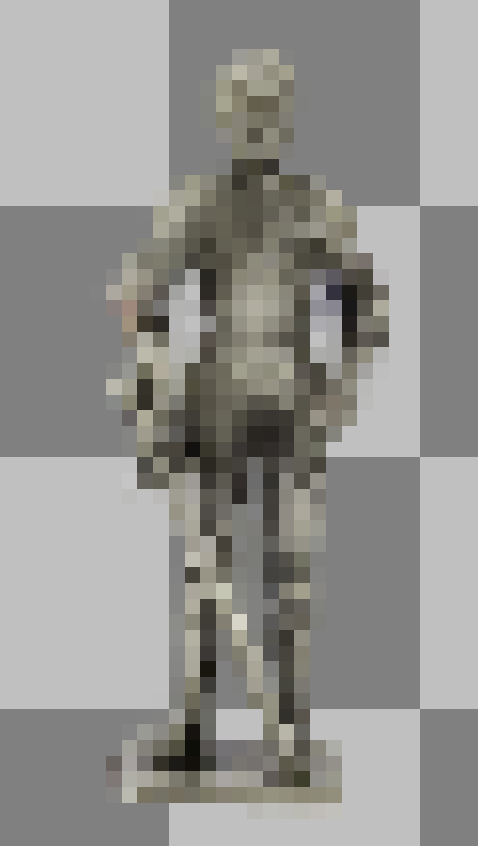
Downscaling

Slide 50


Animations
3. Study existing games
Terraria
Titan Souls

Slide 51
Lighting
1. Predrawn (i.e on image)

Slide 52


Lighting
2. Normal Mapping

Slide 53

Lighting
2. Normal Mapping
The Siege and the Sandfox (UE4)

Slide 54

Lighting
2. Normal Mapping

Slide 55

Normal Mapping
a. From grayscale of original

Slide 56


Normal Mapping
b. From heightmap

Slide 57

Normal Mapping
c. Hand painted
The Siege and the Sandfox (UE4)

Slide 58

Normal Mapping
c. Hand painted
The Siege and the Sandfox (UE4)

Slide 59

Lighting
3. From Voxel Art

Slide 60


Lighting
3. From Voxel Art

Slide 61

Lighting
3. From Voxel Art

Slide 62

Pixel Art in modern game engines
The Last Night (Unity)

Slide 63

Pixel Art in modern game engines
The Siege and the Sandfox (UE4)

Slide 64
References
https://www.creativeshrimp.com/the-secret-of-high-quality-art.html
http://www.neilblevins.com/cg_education/primary_secondary_and_tertiary_shapes/primary_secondary_and_tertiary_shapes.htm
https://pixabay.com/
https://www.creativebloq.com/illustration/examples-pixel-art-2132036
Stickman Spritesheet - pinkuboa.tumblr.com
https://www.gamasutra.com/view/news/312977/Adding_depth_to_2D_with_handdrawn_normal_maps_in_The_Siege_and_the_Sandfox.php
https://80.lv/articles/the-siege-and-the-sandfox-pixel-art-game-with-ue4/
Dynamically Lit Pixel Art - Unreal Engine 4 - YouTube
How To Make Pixel Art From A Photograph Using Gimp - YouTube
The Last Night - E3 2017 reveal trailer - YouTube
The Last Night: The Journey to One of the Most Beautiful Games of E3 - IGN First - YouTube
Siege and Sandfox Gameplay - 2D STEALTH METROIDVANIA - YouTube
PIXEL ART in UNREAL - Building a Metroidvania - YouTube
https://terraria.org/
https://www.aseprite.org/
https://color.adobe.com/
https://www.gimp.org/
https://www.devolverdigital.com/games/view/titan-souls

